Slide 1
SALES ANALYSIS DASHBOARD
Analysis of organizational sales data using Power BI
Covers sales, profit, quantity, discounts, customers, products, and regions
Built with interactive visuals for trend, comparison, and relationship analysis
Objective: support data-driven business decisions

Slide 2
Business Objective
Track total sales and profit over time
Identify top customers and top products
Analyze sales and profit by category and sub-category
Understand regional and city-level performance
Study the impact of discounts and shipping modes

Slide 3
Dataset Overview
Time: Order Date (Year, Month)
Customer: Customer Name, Segment
Product: Category, Sub-Category, Product Name
Geography: Region, City
Measures: Sales, Profit, Quantity, Discount, Ship Mode

Slide 4
Methodology
Cleaned and prepared data using Power Query
Created DAX measures for:
Total Sales
Total Profit
Quantity
Profit Margin
Average Discount
Designed visuals based on analytical requirement
Validated insights using multiple chart types

Slide 5
Analytical Approach
Descriptive analysis: Sales, profit, quantity overview
Trend analysis: Monthly and yearly sales patterns
Comparative analysis: Customers, products, categories, regions
Relationship analysis: Discount vs profit
Geographic analysis: City-level sales distribution

Slide 6
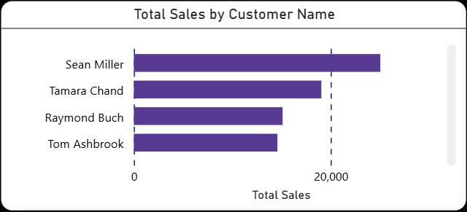
Total Sales by Customer
Visual: Bar Chart – Total Sales by Customer Name
Key Points:
Identifies top-performing customers
Highlights revenue concentration among few customers
Useful for customer prioritization and retention strategies

Slide 7
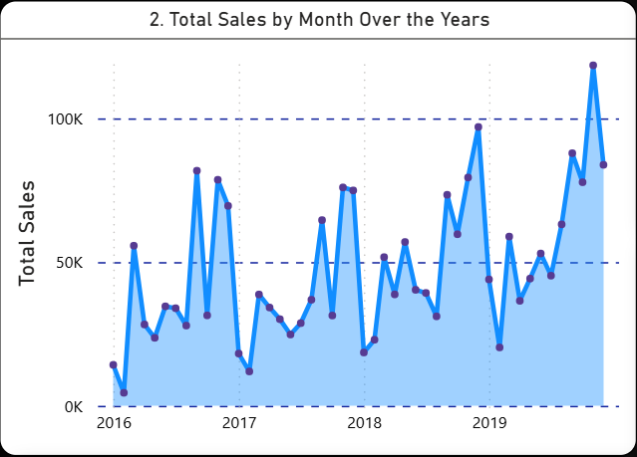
Monthly Sales Trend Over the Years
Visual: Line Chart – Total Sales by Month (2016–2019)
Key Insights:
Sales fluctuate month to month
Overall upward trend visible in later years
Seasonal spikes indicate peak sales periods

Slide 8
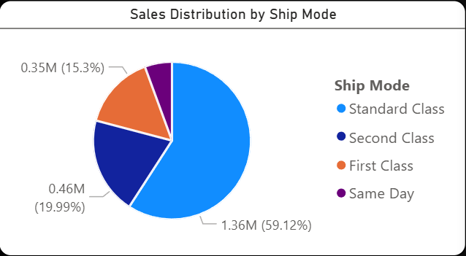
Sales Distribution by Ship Mode
Visual: Pie Chart – Sales by Ship Mode
Insights:
Standard Class contributes the majority of sales
Faster shipping modes contribute less volume
Useful for logistics and cost optimization decisions

Slide 9
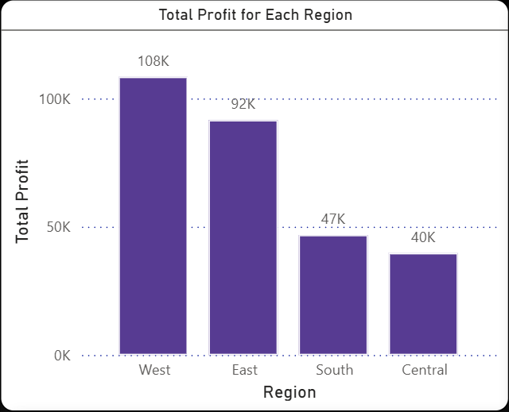
Total Profit by Region
Visual: Column Chart – Profit by Region
Key Findings:
West and East regions generate higher profits
Central and South lag behind
Highlights regions needing strategic focus

Slide 10
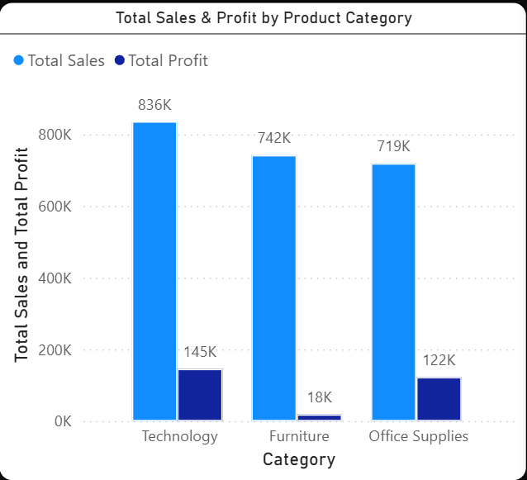
Sales & Profit by Product Category
Visual: Clustered Column Chart
Insights:
Technology category leads in both sales and profit
Furniture shows moderate sales with lower profit
Office Supplies contribute steadily

Slide 11
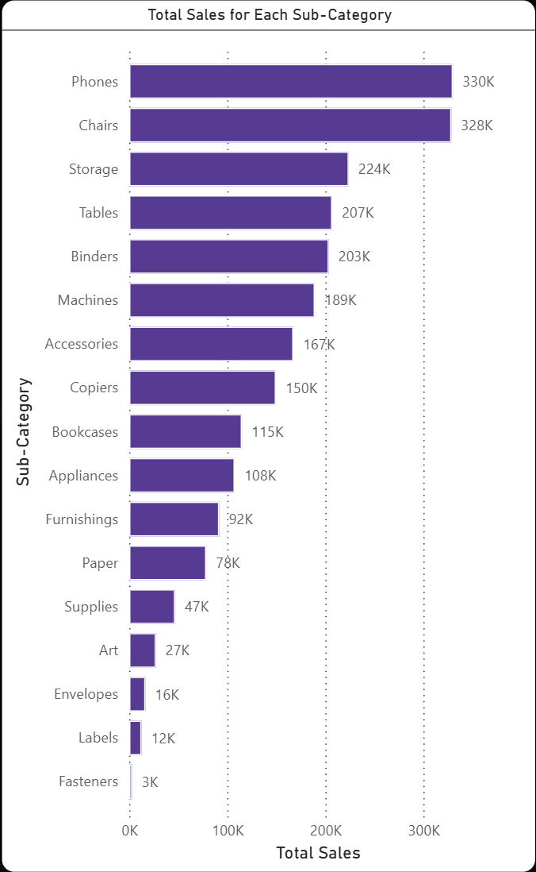
Total Sales by Sub-Category
Visual: Bar Chart : Sales by Sub-Category
Insights:
Phones and Chairs are top-selling sub-categories
Low-performing sub-categories identified
Supports inventory and product portfolio decisions

Slide 12
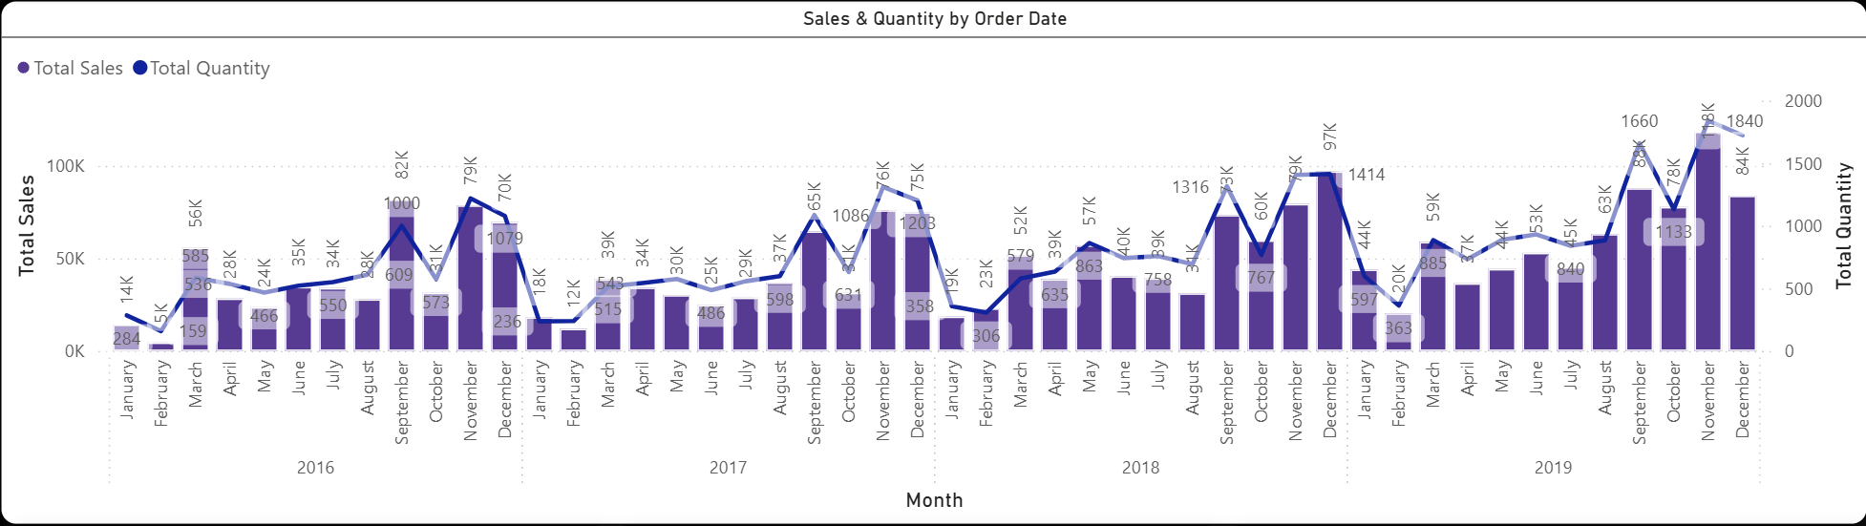
Sales & Quantity by Order Date
Visual: Dual-Axis Chart (Sales & Quantity)
Insights:
Sales and quantity don’t always move together
High quantity does not always mean high revenue
Helps evaluate pricing and volume strategies

Slide 13
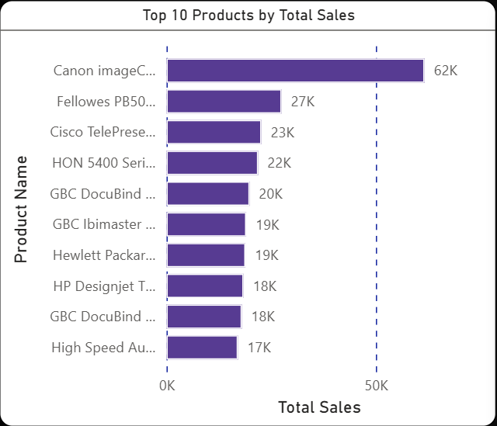
Top 10 Products by Sales
Visual: Bar Chart – Top 10 Products
Key Insights:
Few products drive a large share of revenue
Helps focus promotions and stock planning
Identifies star products

Slide 14
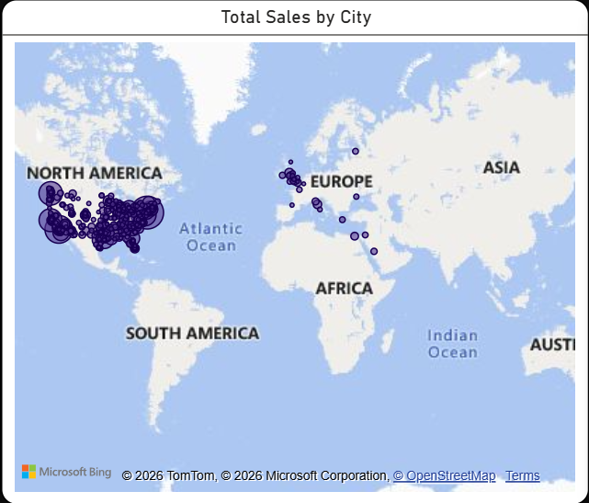
Total Sales by City
Visual: Map Visualization
Insights:
Sales concentrated in specific cities
Geographic clusters clearly visible
Supports regional marketing and expansion planning

Slide 15
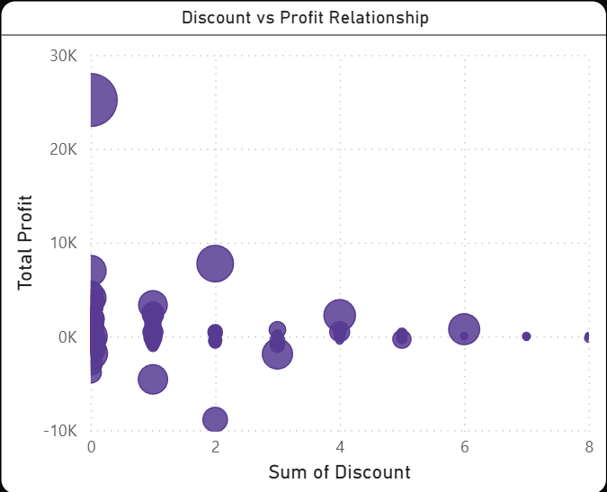
Discount vs Profit Relationship
Visual: Scatter Plot – Discount vs Profit
Key Insights:
Higher discounts often reduce profit
Some discounts still generate positive profit
Helps design better discount strategies

Slide 16
Key Findings
Sales are unevenly distributed across customers and products
Technology category is the strongest performer
Certain regions and cities dominate profit contribution
Discounts have a visible impact on profitability

Slide 17
Actionable Recommendations
Focus retention efforts on high-value customers
Optimize discounts to protect profit margins
Strengthen underperforming regions with targeted strategies
Prioritize top-performing products and sub-categories

Slide 18
Insights for Business
Sales growth does not always mean profit growth
Shipping mode preferences influence operational decisions
Regional and city-level insights support localized strategies

Slide 19
Conclusion
This sales analysis brings clarity to how customers, products, regions, discounts, and shipping modes affect overall business performance.
The dashboard makes it easy to identify strong revenue drivers as well as areas that need attention.
Trends across months and years show that growth is uneven, which highlights the need for focused, data-backed decisions rather than broad strategies.
By presenting insights through clear and interactive visuals, the analysis supports practical decision making and helps the business respond more effectively to changing sales patterns.

